Slide 1
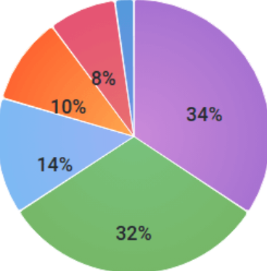
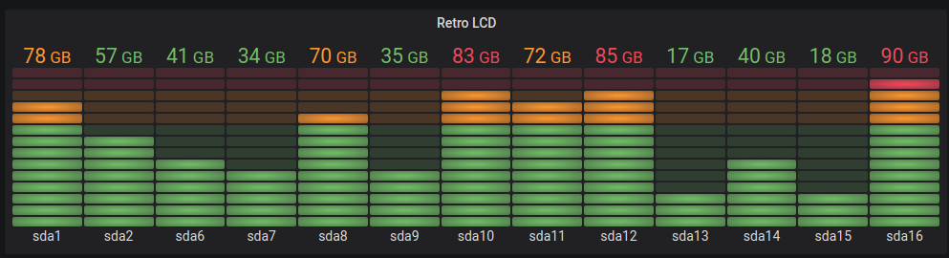
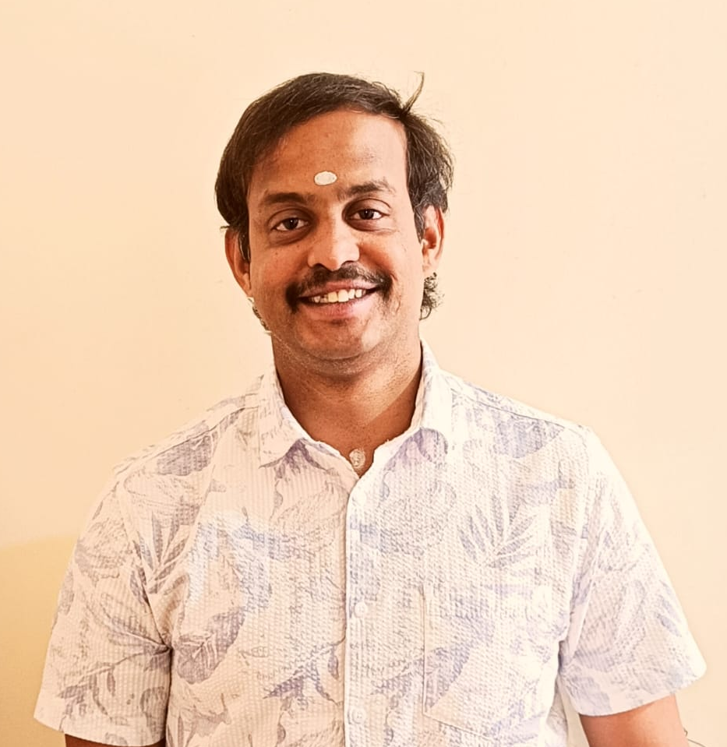
Mastering Visualizations – Build Grafana Dashboards Like a Pro
Chandra Mohan Dhanasekaran
AWS Cloud Architect @ Philips

Slide 2
Session Outline
About Me
What is Grafana?
Building Blocks of Grafana
Visualizations and Panels
Why we need visualizations?
Demo – Status History and Canvas Panels
References

Slide 3






About Me
A Proud Dad of 2 Amazing Boys
Senior AWS Cloud Architect @ Philips
15+ Years experience
Docker Captain
Terraform Book Author
Speaker and Active Blogger
Grafana & Serverless Fan
https://www.linkedin.com/in/chandrud
https://chandrud.substack.com
My mission is to reach the student community and early career professionals to make the right career choices and excel in it with the right skillsets to be deemed 100% fit!

Slide 4
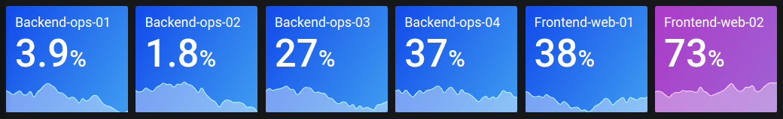
What is Grafana?
Grafana is an open-source observability platform that allows users to visualize, monitor, and analyze metrics, logs, and traces.
It integrates with multiple data sources like Prometheus, Loki, Elasticsearch, InfluxDB, and more.
Offers powerful dashboarding capabilities to create real-time and historical data visualizations.
Used in DevOps, SRE, IoT, and business analytics for monitoring infrastructure, applications, and services.

Slide 5
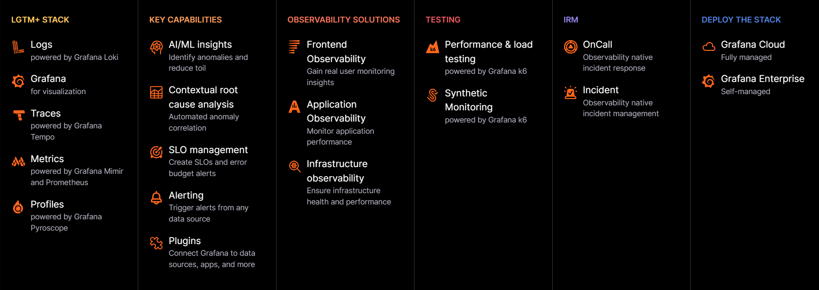
Grafana Ecosystem

Slide 6
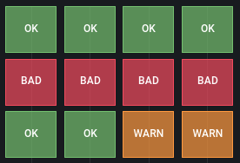
Building Blocks of Grafana
Data Sources: Connectors for pulling data from databases, time-series stores, and monitoring tools.
Dashboards: Custom layouts for organizing and displaying multiple visualizations.
Panels: Individual elements within a dashboard that display data in different formats (graphs, tables, heatmaps, etc.).
Queries: Written in query languages like PromQL (Prometheus), LogQL (Loki), SQL (MySQL/PostgreSQL), etc.
Alerting: Define thresholds and receive notifications via email, Slack, PagerDuty, or other integrations.

Slide 7
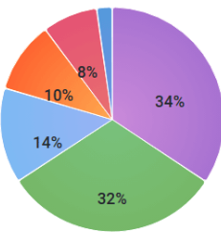
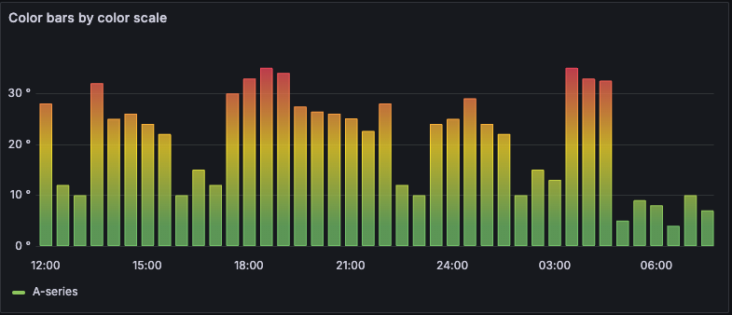
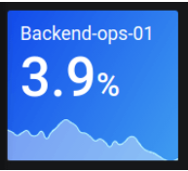
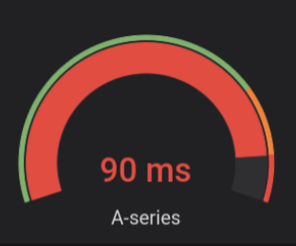
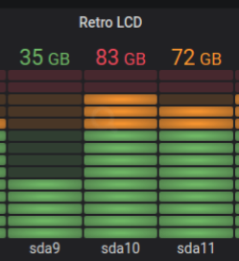
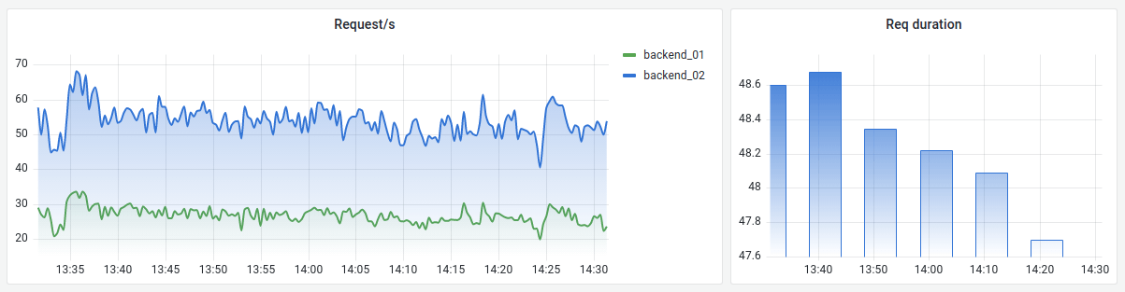
Visualizations

Slide 8
Why we need visualizations?
Improves Observability
Helps in understanding system health and detecting anomalies quickly.
Better Decision-Making
Graphs and trends provide insights for capacity planning and performance tuning.
Enhanced Troubleshooting
Allows engineers to correlate metrics with logs and traces for faster debugging.
Real-time Monitoring
Enables proactive monitoring with alerts before issues impact users.

Slide 9
DEMO TIME

Slide 10

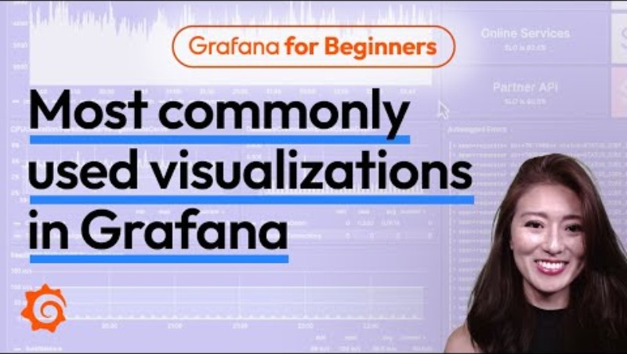


References
https://play.grafana.org
https://grafana.com/docs/grafana/latest/panels-visualizations/visualizations
https://grafana.com/docs/grafana/latest/datasources/testdata/

Slide 11




Any Questions?

Slide 12




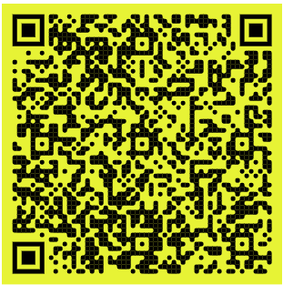
Please feel free to connect! ☺
Session Presentation

